Slide 1
Using AWS Comprehend for aspect based Sentiment Analysis
William Tadlock and Vivian Ellis

Slide 2
What is Sentiment Review Analysis?
Determining the sentiment of each review
Document Level, Sentence Level, Aspect Level
Apply individual sentiments to the respective Level
Could score sentiment based on emotions or a range -1 to 1
Product reviews can be best analyzed through the Aspect Level

Slide 3
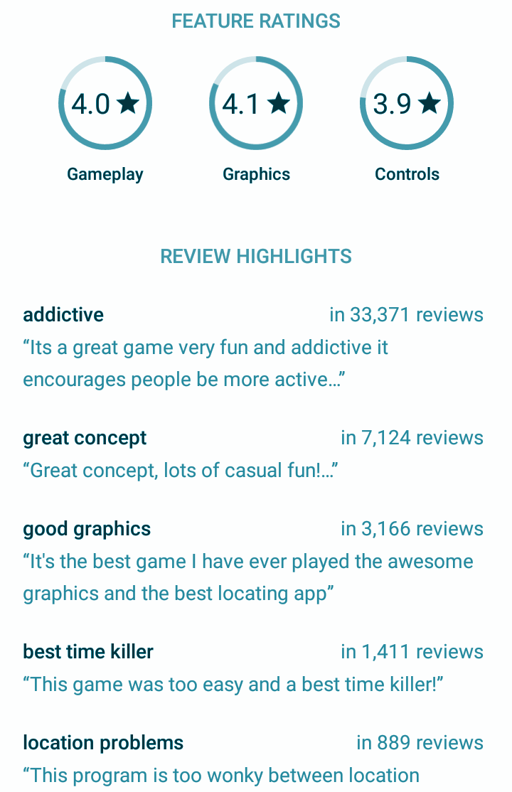
What is Aspect Review Analysis?
Breaking text into aspects
Associating a sentiment with each aspect
Using the aspect sentiments to determine an overall sentiment or aspect sentiments based on overall sentiment?
Each aspect can have a different importance for The product

Slide 4
My Model
Three main modules make up the model
Natural Language Processing(NLP) with AWS Comprehend
Aspect Extraction(AE) from the NLP output
Sentiment Classification (SC) with AWS Comprehend

Slide 5
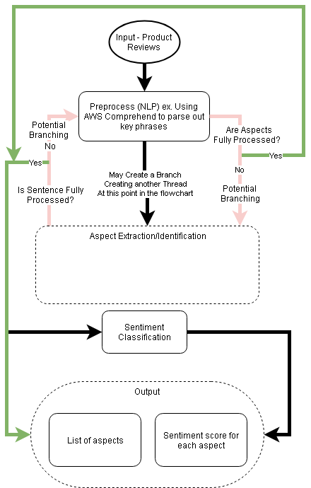
Framework

Slide 6
AWS Comprehend
Reads in reviews from S3
Parses through the data
Outputs
Named Entities
Key Phrases
Syntax
Sentiment

Slide 7
The Data Set
A review set from amazon on AAA Batteries
Currently have not fully modeled the AE module, so using AWS Comprehend to use NLP and SC and breaking into key phrases
Example Reviews
These batteries are very long lasting the price is great.
These do not last long at all very cheap batteries no happy
Well if you are looking for cheap non-rechargeable batteries that last quite a while then these are perfect. Nothing more to say.

Slide 8
Demo!

Slide 9
Challenges
Pre processing each product for related words/aspects/phrases. Currently being done manually to a referenced dictionary
Analyzing sentiments for an aspect mentioned multiple times in a single review document.

Slide 10
Questions?

